Slide 1
Body Composition Assessment
Chapter 13

Slide 2
Objectives
Define overweight, obese, and overfat
Define body mass index and describe the limitations of the formula
Calculate body mass index and interpret BMI based on BMI categories
List types of indirect body composition techniques
Compare and contrast between BOD POD, skinfold, BIA, and DEXA body composition measurement techniques

Slide 3
Reasons to Assess Body Composition
Provides a starting point to base current and future decisions about weight loss and weight gain
Provides realistic goals about how to best achieve an ideal balance between the body’s fat and nonfat compartments

Slide 4
Reasons to Assess Body Composition, continued
Monitors changes in the body’s fat and fat-free components
Allows the health care practitioner to provide quality information related to nutrition , weight control , exercise, training , and rehabilitation

Slide 5
Weight-for-Height Tables
Serve as a benchmark for men and women aged 25-59 years
Based on the average body mass relative to height
Do no provide reliable information about the relative composition of the human body
Notes:
Weight-for-height tables do not consider specific causes of death or disease status before death (morbidity).
“Overweight” and “overfat” often describe different aspects of body composition for physically active men and women.

Slide 6
Body Mass Index (BMI)
Derived from body mass related to stature
Formula to calculate BMI:
Bodymass kg / height m^2
Used to evaluate the normalcy of body size
As BMI increases so does the risk for cardiovascular complications

Slide 7

BMI Categories
Underweight <= 18.5 kg/m^2
Normal Weight <= 18.5 -24.9 kg/m^2
Overweight <= 25-29.9 kg/m^2
Obesity<= 30 kg/m^2
Reference: National, Heart, Lung, and Blood Institute
http://www.nhlbi.nih.gov/health/educational/lose_wt/BMI/bmicalc.htm

Slide 8
BMI, continued
Controversies with using BMI in practice:
Does not account for muscle mass
Athletes often have a high BMI due to muscle which classifies them as obsess but they are not
Underestimates body fat in older persons and other who have lost muscle

Slide 9
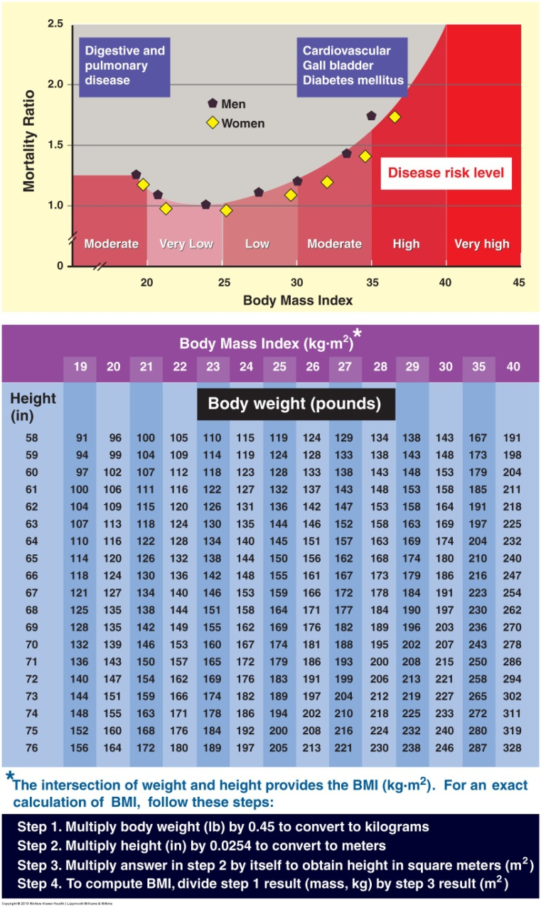
Notes:
Curvilinear relationship based on American Cancer Society data between all-cause mortality and body mass index. The classification schema proposed for very low to very high risk includes a classification relating risk to one of a number of treatments such as reduced food intake, exercise, drug therapy, and surgery.

Slide 10
How to Calculate BMI on slide at 7:57

Slide 11
How to Calculate BMI, continued
9:53

Slide 12
Body Composition Definitions
Overweight: a body weight that exceeds some average for eight and age
Overfat: A condition in which body fat exceeds an age-and/or gender appropriate average by a predetermined amount
Obese: the overfat conditions that accompanies comorbidities that include one or all of the following:
Glucose intolerance
Insulin resistance
Dyslipidemia
Type 2 diabetes
Hypertension
Elevated plasma leptin concentrations
Increased visceral adipose tissue
Increased coronary heart disease risk
Increased cancer risk
Notes:
Research and contemporary discussion among diverse disciplines emphasizes the need to distinguish between overweight, overfat, and obesity to insure consistency in use and interpretation.

Slide 13
Essential and Storage Fat
Essential fat: fat stored in the bone marrow, heart. Lungs. Liver, spleen kidneys intestines muscles and lipid rich tissues of the central nervous system
normal physiologic functioning requires this fat
Storage fat depot consist of fat accumulation in adipose tissue
Reference man : 12% storage fat
Reference woman: 15% storage fat
Notes:
Storage fat includes the visceral fatty tissues that protect the various internal organs within the thoracic and abdominal cavities and the larger subcutaneous fat tissue volume deposited beneath the skin’s surface.

Slide 14
Fat-Free Body Mass and Lean Body Mass
Lean body mass LBM contains a small % of essential fat stores equivalent to approximately 3% of body mass
Fat free body mass FFM represents the body devoid of all extractable fat
In normally healthy adults FFM and LBM differ only in the essential lipid rich stores in the bone marrow brain spinal cord and internal organs
Notes:
LBM calculations include the small quantity of essential fat, whereas FFM computations exclude “total” body fat.

Slide 15
Assessment of Body Composition: Direct vs. Indirect Measures
Direct Measurement
Requires chemical analysis of the animal carcass or human cadaver
Time consuming
Expensive
Indirect Measurement*
Simple anthropometric measurements
Noninvasive procedures

Slide 16
Types of Indirect Assessment Techniques
Hydrostatic weighing
Skinfold thickness
Girth measurements
Bioelectrical impedance analysis
Near-infrared interactance
CT or MRI
Dual-energy x-ray absorptiometry DEXA
BOD POD

Slide 17
Hydrostatic Weighing
Based on Archimedes’ principle
Dividing a person’s body mass by body volume yields body density and from this an estimate of percentage body fat
Involves immersion in water
Notes:
Applying constant density values for the fat and fat-free tissues to growing children or aging adults introduces errors in predicting body composition.

Slide 18
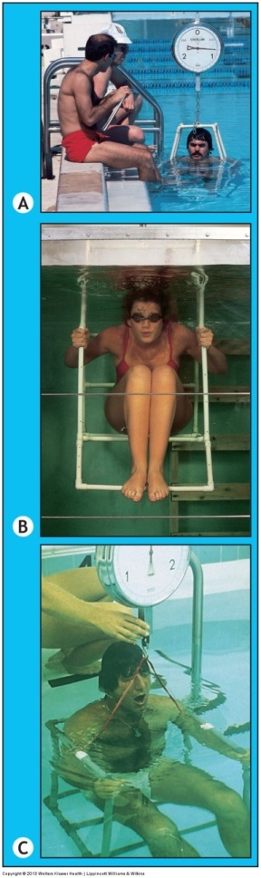
Notes:
Measuring body volume by underwater weighing. Prone and supine methods for underwater weighing with no difference in results, with residual lung volume measured before, during, or after the underwater weighing. Measurements taken (A) prone, (B) seated in a swimming pool, (C) seated in a therapy pool, and (D) upright in a stainless steel tank with Plexiglas front in the laboratory. For any method, subjects can use a snorkel with nose clip if apprehensive about submersion. Final calculation of underwater weight must account for these objects.

Slide 19
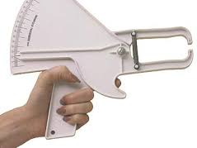
Skinfold Measurements
The rationale for using skinfolds to estimate body fat is based on 3 factors:
Fat in the adipose tissue deposits directly beneath the skin subcutaneous fat
Internal fat
Whole body density
Most common anatomic locations for skinfold measurement include:
Triceps subscapular suprailiac abdominal and upper thigh sites

Slide 20
Skinfold Measurements, continued
Requires grasping a fold of skin and subcutaneous fat firmly with the thumb and forefingers and pulling it away from the underlying muscle tissue
The pincer jaws used for precise measurement
The caliper dial indicates skinfold thickness in millimeters
Notes:
This time limitation avoids excessive skinfold compression when taking the measurement.

Slide 21
Limitations to Use of Skinfold Measurements
The person taking skinfold must develop technical expertise with the proper measurement techniques
With extremely obese people skinfold thickness often exceeds the width of the caliper’s jaws
The particular caliper used can contribute to measurement erros

Slide 22
Bioelectrical Impedance Analysis (BIA)
An electric current is introduced and the impedance resistance to current flow is determined between the source and the detector electrodes
Conversion of the impedance value to body density adding body mass and stature sex age and sometimes race level of fatness and several girths to the equation computes percent of body fat

Slide 23
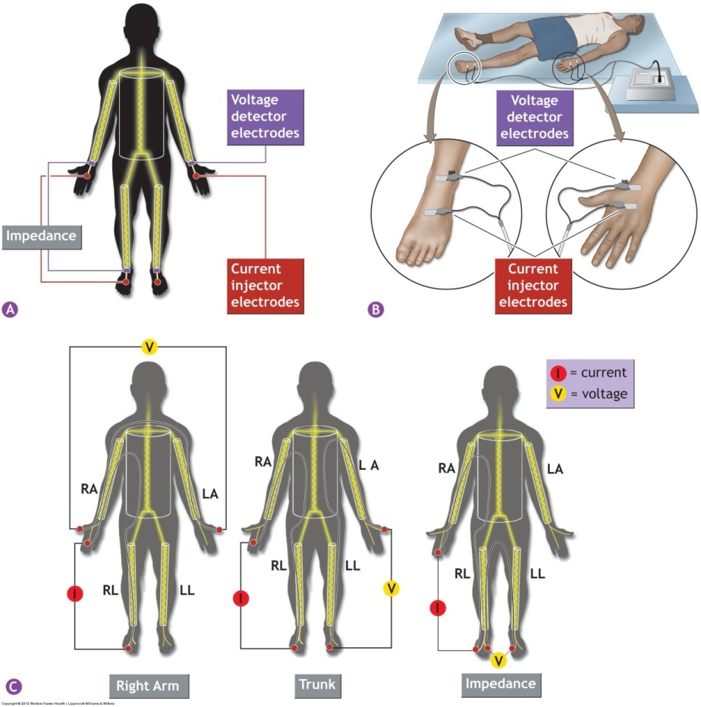
Notes:
Common calipers for skinfold measurement. The Harpenden and Lange calipers provide constant tension at all jaw openings.

Slide 24
BIA Limitations
Hydration level even small changes that occur with exercise affects BIA accuracy and may give inaccurate information about a persons’s body fat content
Hypohydration and hyperhydration alter normal electrolyte concentrations which in turn affect current flow independent of real change in body composition
Skin temperature influenced by ambient conditions also affects whole body resistance and thus the bia prediction of body fat
Notes:
A lower predicted body fat value occurs in a warm environment (less impedance to electrical flow) than in a cold one.

Slide 25
CT and MRI
Computed tomography ct and magnetic resonance imaging MRI produce images of body segments
CT scans can evaluate the relationship between simple anthropometric measures at the abdominal region and total adipose tissue volume
Mri quantifies total subcutaneous adipose tissue in individuals of varying degrees of body fatness.

Slide 26
Dual-Energy X-Ray Absorptiometry
Quantifies fat and non-bone regional lean body mass
Clinical tool to assess spinal osteoporosis and related bone disorders
Computer software reconstructs the attenuated x-ray beams to produce an image of the underlying tissues and quantify bone mineral content, total fat mass and FFM
Notes:
Analyses also include selected trunk and limb regions for detailed study of tissue composition and possible relation to disease risk, including the effects of exercise training and detraining.

Slide 27
BOD POD
Uses air displacement to estimate body volume
Body density computes as body mas measured in air / body volume measured in BOD POD
The siri equation converts body density to % of body fat

